Slide 1
Session #11:
Image Segmentation
Mithun Kumar S R
mithunkumar.sr@wilp.bits-pilani.ac.in
Acknowledgement: Slide Materials adopted from - EECS 442 – David Fouhey

Slide 2
Aakash Goel https://www.linkedin.com/in/goelaakash123/
Session 10:
Image Segmentation
Acknowledgement: Slide Materials adopted from - Intro to Computer Vision (Cornell Tech); Noah Snavely, prepared by the lead instructor Prof S P Vimal , modified (added some content) by Aakash Goel

Slide 3
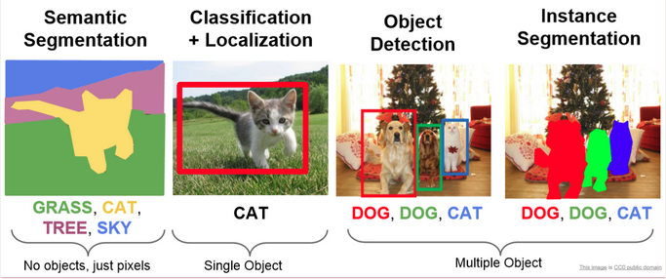
Image Segmentation
Image segmentation is a process in computer vision that involves dividing an image into multiple segments, or regions, to simplify or change the representation of an image into something more meaningful and easier to analyze. It's often used to locate objects and boundaries within images.

Slide 4
Types
Semantic Segmentation: Assigns a label to every pixel in the image, meaning each pixel is classified as belonging to a specific object class (e.g., car, tree, road).
Instance Segmentation: Similar to semantic segmentation but differentiates between different instances of the same object class (e.g., multiple cars in an image).
Panoptic Segmentation: A combination of both semantic and instance segmentation, providing a comprehensive view by segmenting both object instances and the background.
Thresholding: Simplest form where pixels are classified based on a threshold value.
Edge-based Segmentation: Uses edges (sharp changes in intensity) to identify objects.
Region-based Segmentation: Groups pixels into regions based on some predefined criteria like color, intensity, or texture.

Slide 5
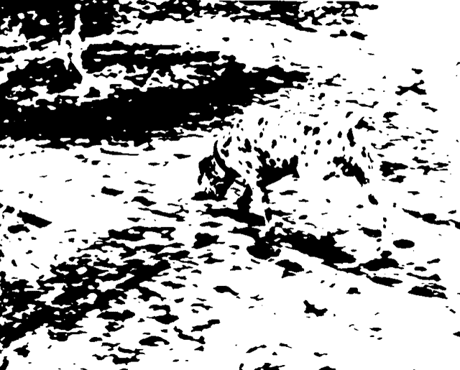
Image Segmentation
Gestalt psychology
We perceive objects in its entirety before their individual parts

Slide 6
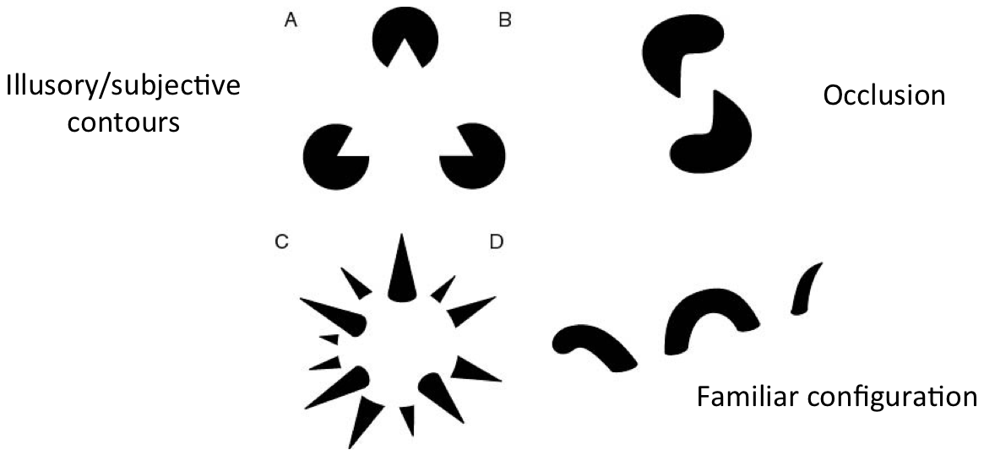
Gestalt: Seeing the unified whole
https://ai.stanford.edu/~syyeung/cvweb/tutorial3.html

Slide 7
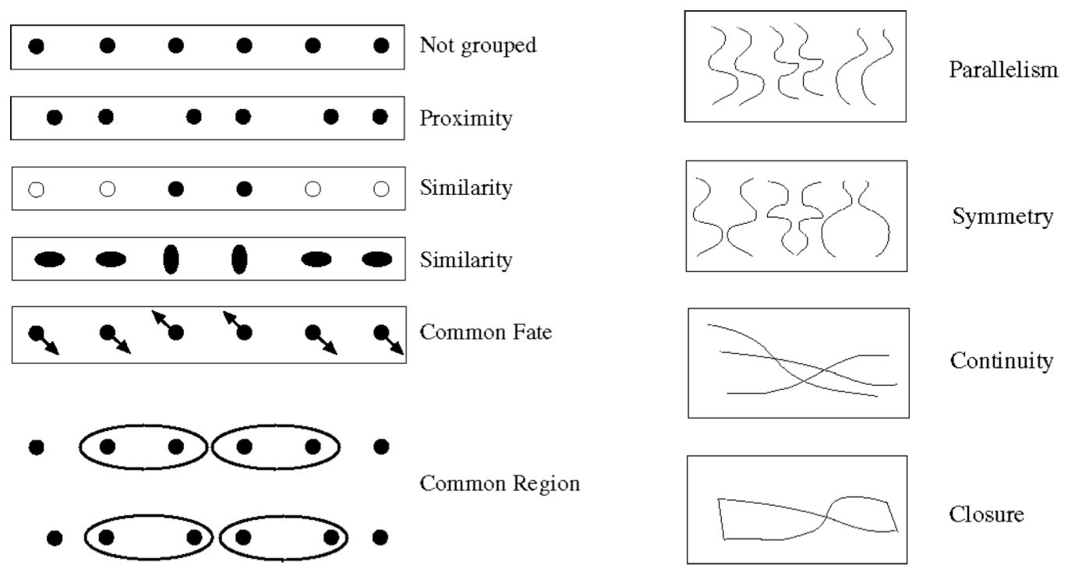
Human perception of shape recognition
https://ai.stanford.edu/~syyeung/cvweb/tutorial3.html

Slide 8
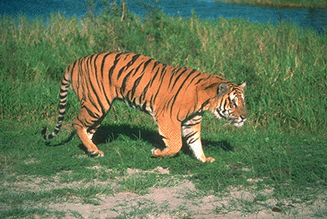
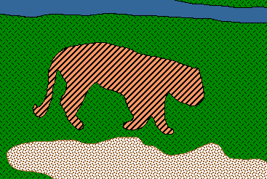
From images to objects
What Defines an Object?
Subjective problem, but has been well-studied
Gestalt Laws seek to formalize this
proximity, similarity, continuation, closure, common fate
see notes by Steve Joordens, U. Toronto

Slide 9
Image Segmentation
Intuitive to us
Hard to translate to algorithms
Strategies:
Top Down
Pixels belong together because they come from the same object
Bottom Up
Pixels belong together because they look similar

Slide 10

Image histograms
How many “orange” pixels are in this image?
This type of question answered by looking at the histogram
A histogram counts the number of occurrences of each color
Given an image
The histogram is defined to be

Slide 11
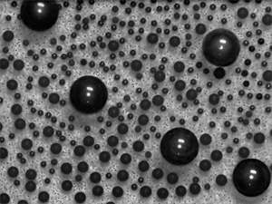
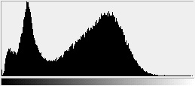
What do histograms look like?
How Many Modes Are There?
Easy to see, hard to compute

Slide 12
Histogram-based segmentation
Goal
Break the image into K regions (segments)
Solve this by reducing the number of colors to K and mapping each pixel to the closest color
photoshop demo

Slide 13
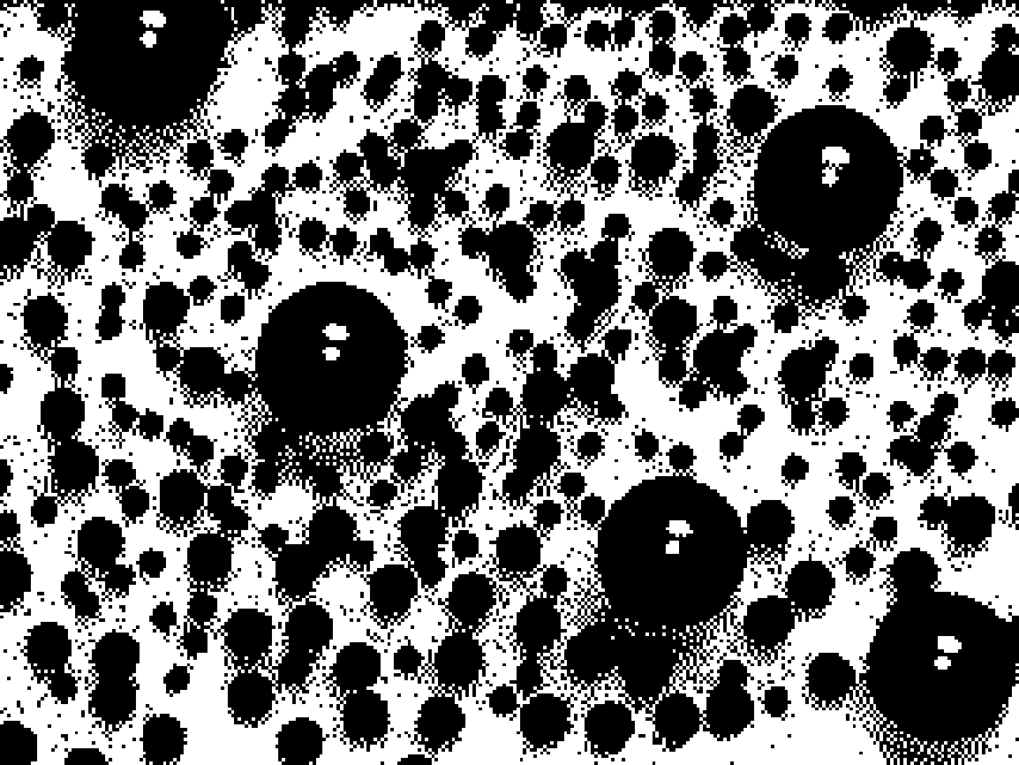
Histogram-based segmentation
Goal
Break the image into K regions (segments)
Solve this by reducing the number of colors to K and mapping each pixel to the closest color
photoshop demo
Here’s what it looks like if we use two colors

Slide 14



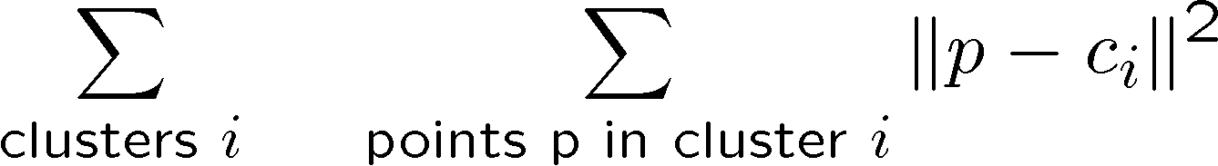
Clustering
How to choose the representative colors?
This is a clustering problem!
G
G
R
R
Objective
Each point should be as close as possible to a cluster center
Minimize sum squared distance of each point to closest center

Slide 15
Break it down into subproblems
Suppose I tell you the cluster centers c_{i}
Q: how to determine which points to associate with each c_{i}?
A: for each point p, choose closest c_{i}
Suppose I tell you the points in each cluster
Q: how to determine the cluster centers?
A: choose c_{i} to be the mean of all points in the cluster

Slide 16
K-means clustering
K-means clustering algorithm
Randomly initialize the cluster centers, c₁, ..., c_{K}
Given cluster centers, determine points in each cluster
For each point p, find the closest c_{i}. Put p into cluster i
Given points in each cluster, solve for c_{i}
Set c_{i} to be the mean of points in cluster i
If c_{i} have changed, repeat Step 2
Demo: https://ai.stanford.edu/~syyeung/cvweb/tutorial3.html
Properties
Will always converge to some solution
Can be a “local minimum”
does not always find the global minimum of objective function:

Slide 17
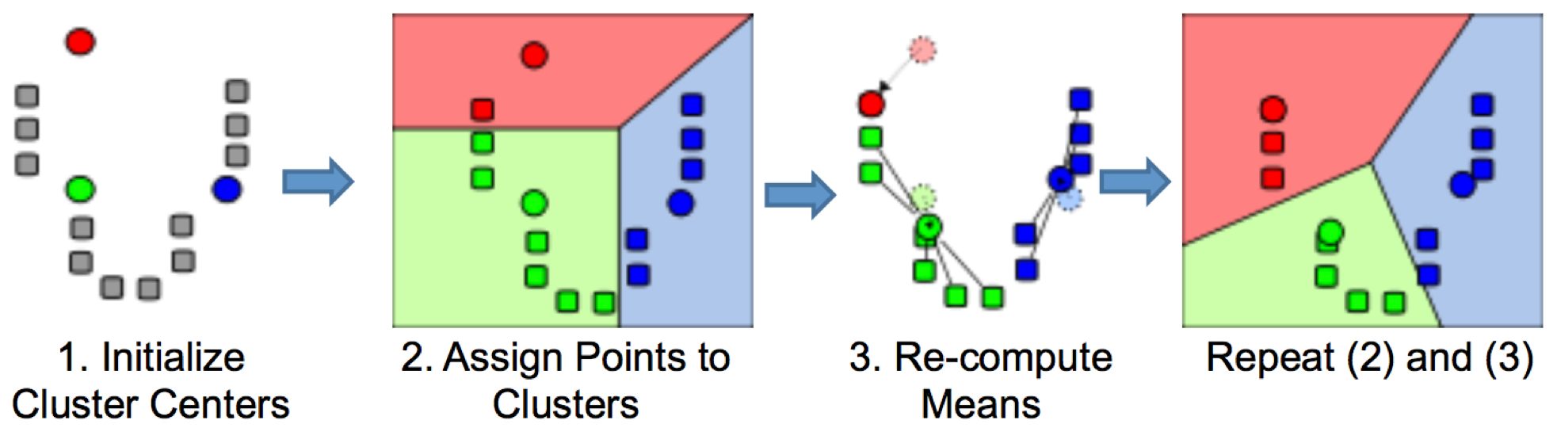
K means clustering

Slide 18
Probabilistic clustering
Basic questions
what’s the probability that a point x is in cluster m?
what’s the shape of each cluster?
K-means doesn’t answer these questions
Basic idea
instead of treating the data as a bunch of points, assume that they are all generated by sampling a continuous function
This function is called a generative model
defined by a vector of parameters θ

Slide 19
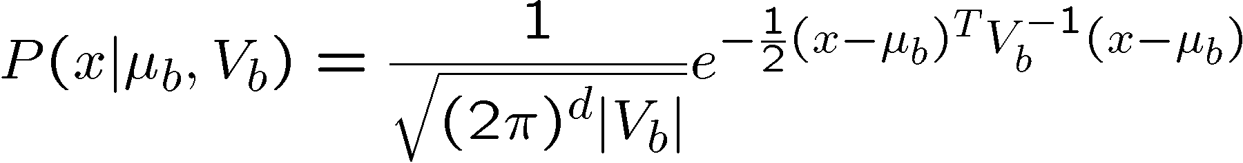

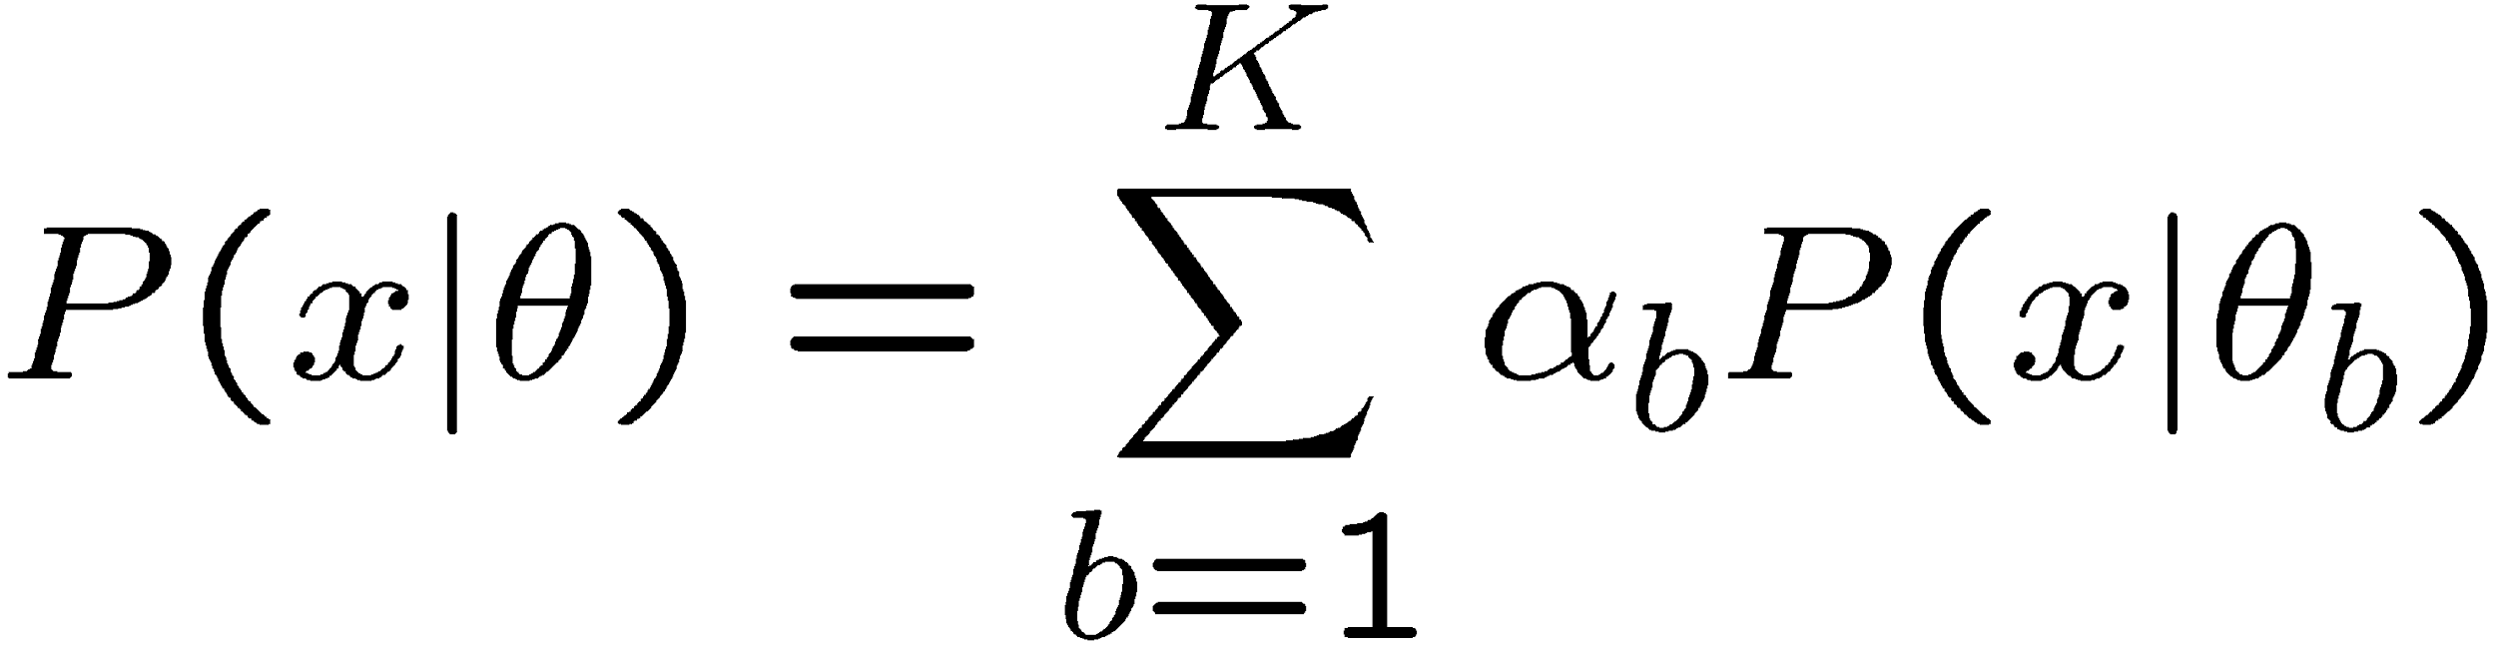
Mixture of Gaussians
One generative model is a mixture of Gaussians (MOG)
K Gaussian blobs with means μ_{b} covariance matrices V_{b}, dimension d
blob b defined by:
blob b is selected with probability
the likelihood of observing x is a weighted mixture of Gaussians
where

Slide 20
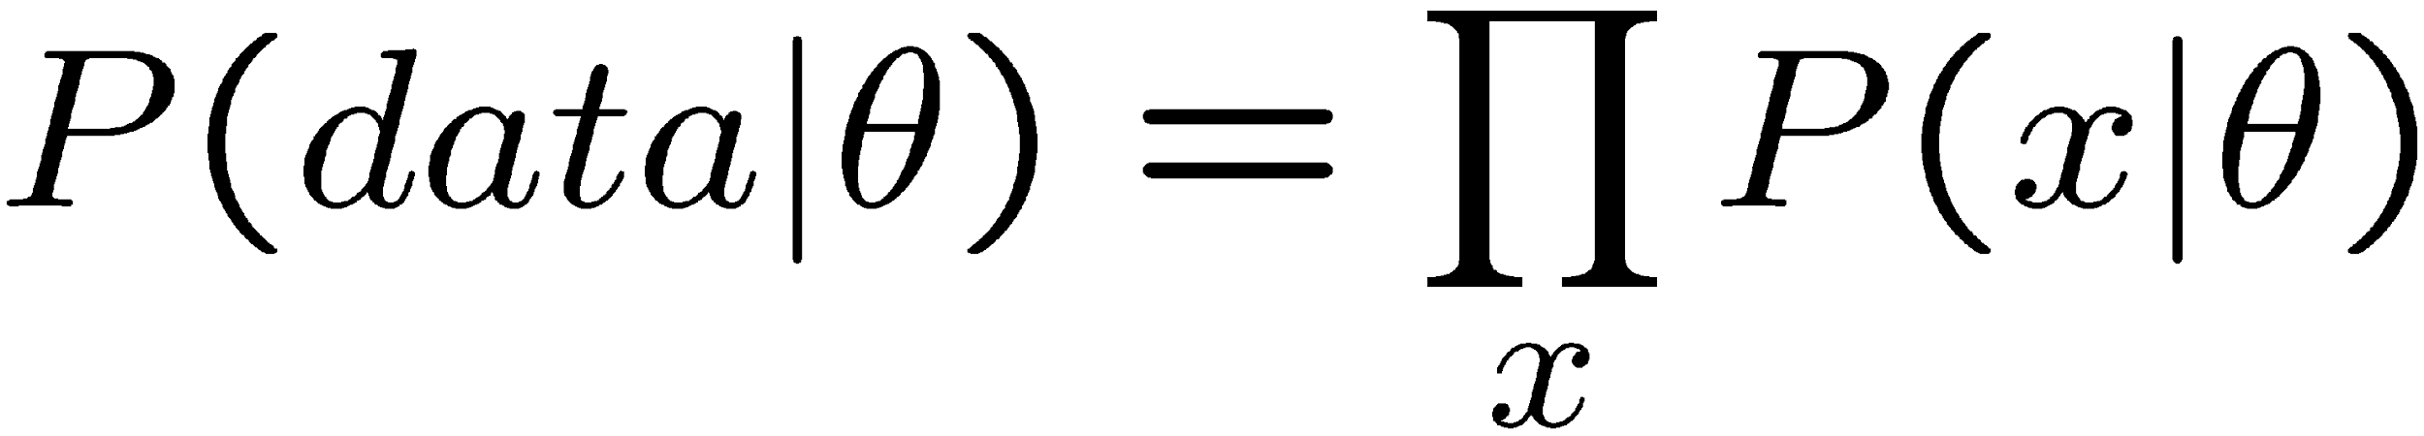
Expectation maximization (EM)
Goal
find blob parameters θ that maximize the likelihood function:
Approach:
E step: given current guess of blobs, compute ownership of each point
M step: given ownership probabilities, update blobs to maximize likelihood function
repeat until convergence

Slide 21
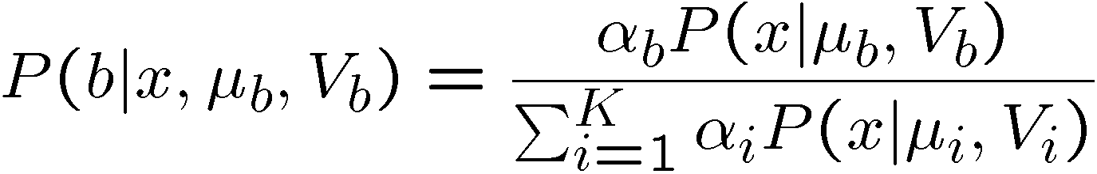
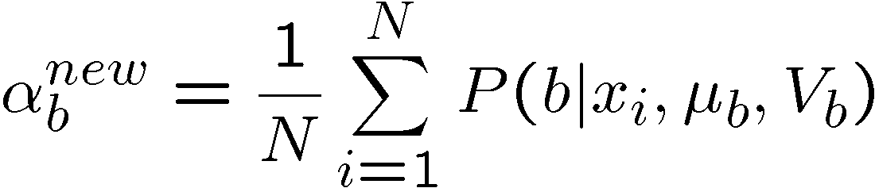
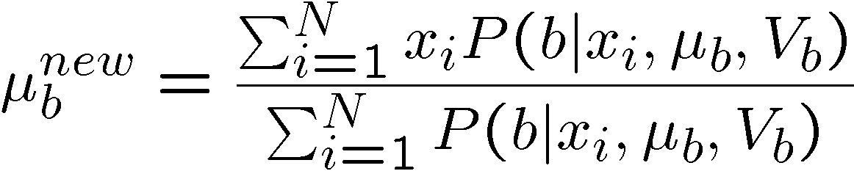
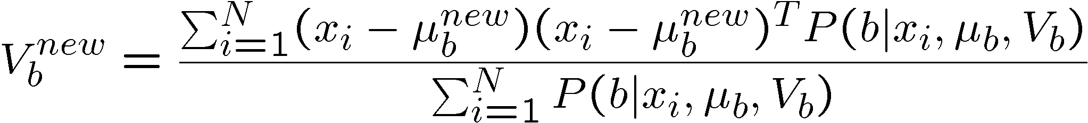
EM details
E-step
compute probability that point x is in blob i, given current guess of θ
M-step
compute probability that blob b is selected
mean of blob b
covariance of blob b
N data points

Slide 22
EM demos
https://github.com/annoviko/pyclustering

Slide 23
Applications of EM
Turns out this is useful for all sorts of problems
any clustering problem
any model estimation problem
missing data problems
finding outliers
segmentation problems
segmentation based on color
segmentation based on motion
foreground/background separation
...

Slide 24
Problems with EM
Local minima
Need to know number of segments
Need to choose generative model

Slide 25
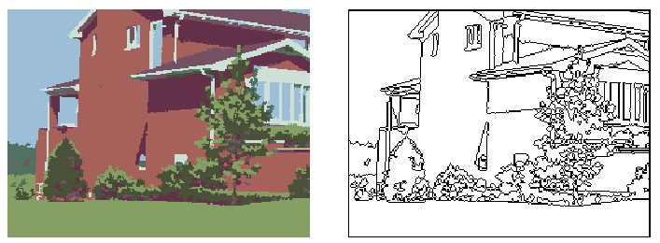
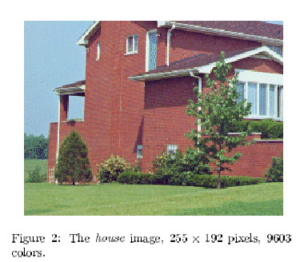
Mean-shift for image segmentation
Useful to take into account spatial information
instead of (R, G, B), run in (R, G, B, x, y) space
D. Comaniciu, P. Meer, Mean shift analysis and applications, 7th International Conference on Computer Vision, Kerkyra, Greece, September 1999, 1197-1203.
http://www.caip.rutgers.edu/riul/research/papers/pdf/spatmsft.pdf
More Examples: http://www.caip.rutgers.edu/~comanici/segm_images.html

Slide 26
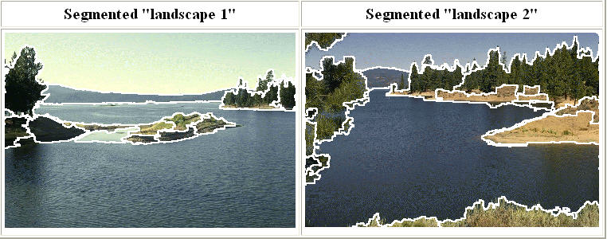
Mean shift segmentation
D. Comaniciu and P. Meer, Mean Shift: A Robust Approach toward Feature Space Analysis, PAMI 2002.
Versatile technique for clustering-based segmentation

Slide 27
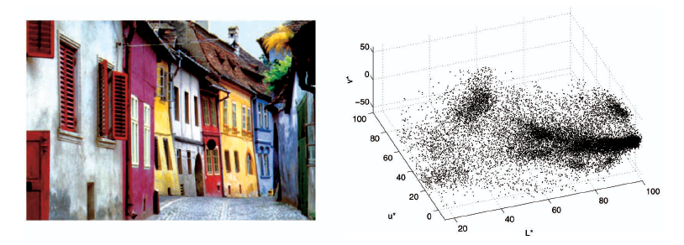
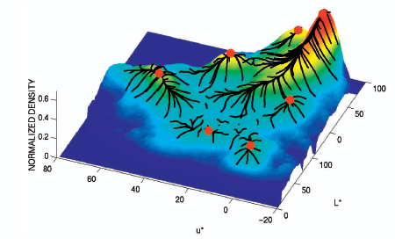
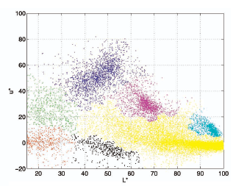
Mean shift algorithm
Try to find modes of this non-parametric density

Slide 28


Kernel density estimation
Kernel density estimation function
Gaussian kernel

Slide 29
Mean shift
CV 11: Image Segmentation
Region of
interest
Center of
mass
Mean Shift
vector
Slide by Y. Ukrainitz & B. Sarel

Slide 30
Mean shift
CV 11: Image Segmentation
Region of
interest
Center of
mass
Mean Shift
vector
Slide by Y. Ukrainitz & B. Sarel

Slide 31
Mean shift
Region of
interest
Center of
mass
Mean Shift
vector
Slide by Y. Ukrainitz & B. Sarel

Slide 32
Mean shift
Region of
interest
Center of
mass
Mean Shift
vector
Slide by Y. Ukrainitz & B. Sarel

Slide 33
Mean shift
CV 11: Image Segmentation
Region of
interest
Center of
mass
Mean Shift
vector
Slide by Y. Ukrainitz & B. Sarel

Slide 34
Mean shift
CV 11: Image Segmentation
Region of
interest
Center of
mass
Mean Shift
vector
Slide by Y. Ukrainitz & B. Sarel

Slide 35
Mean shift
Region of
interest
Center of
mass
Slide by Y. Ukrainitz & B. Sarel

Slide 36
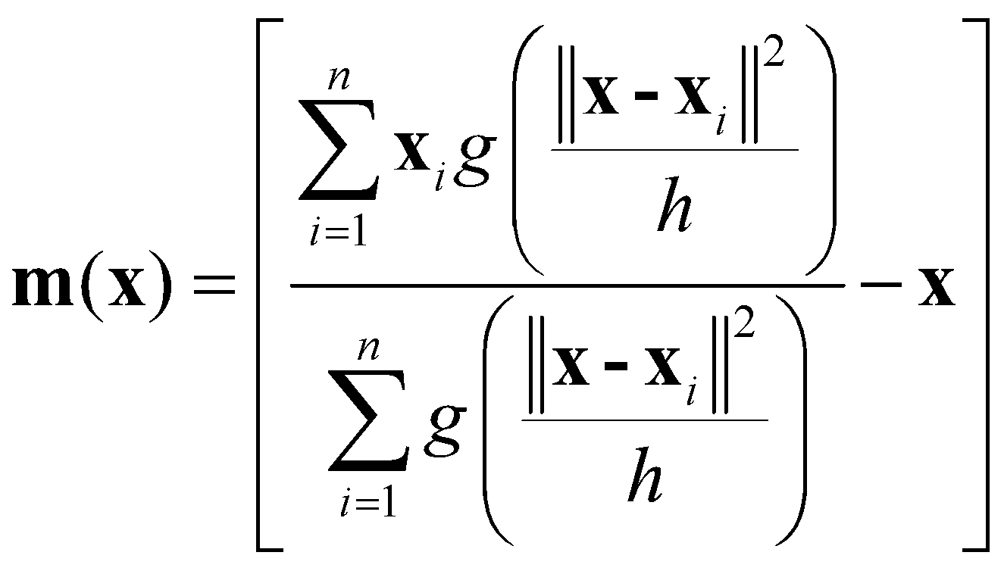
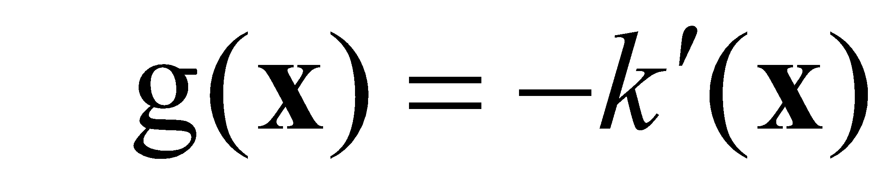
Computing the Mean Shift
Simple Mean Shift procedure:
Compute mean shift vector
Translate the Kernel window by m(x)
Slide by Y. Ukrainitz & B. Sarel

Slide 37
Real Modality Analysis

Slide 38
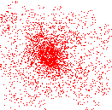
Attraction basin
Attraction basin: the region for which all trajectories lead to the same mode
Cluster: all data points in the attraction basin of a mode
Slide by Y. Ukrainitz & B. Sarel

Slide 39
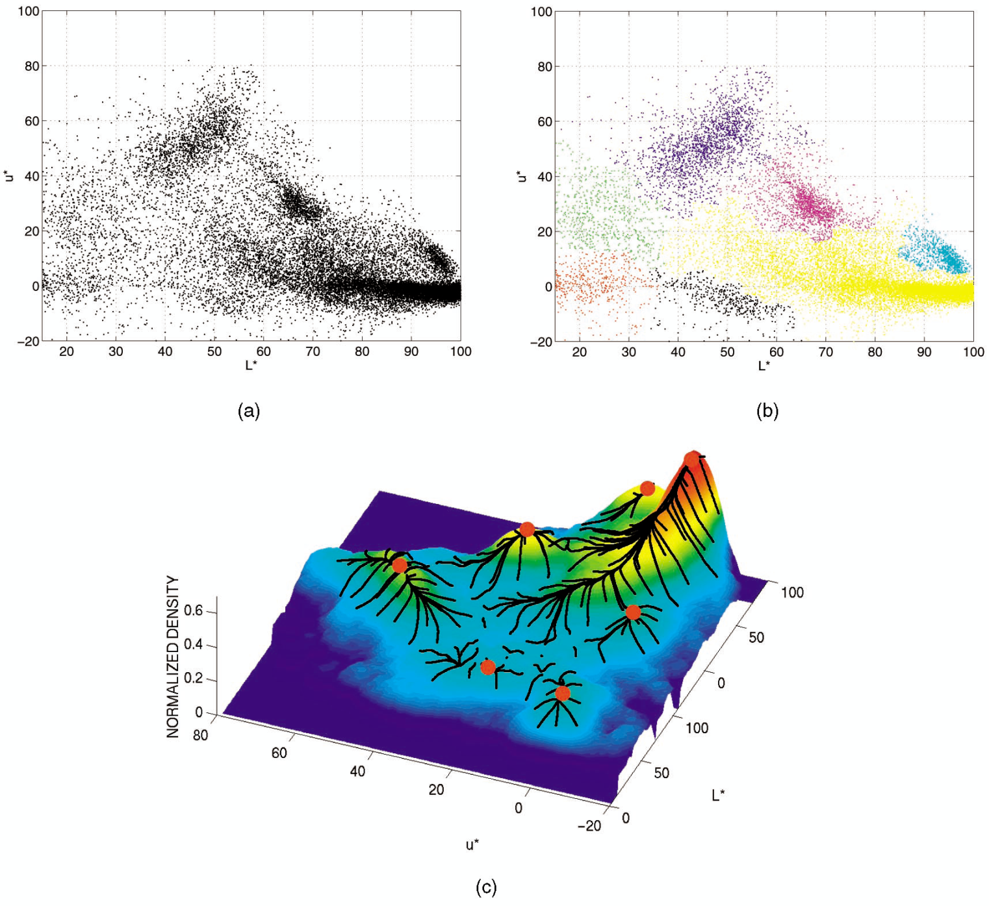
Attraction basin

Slide 40
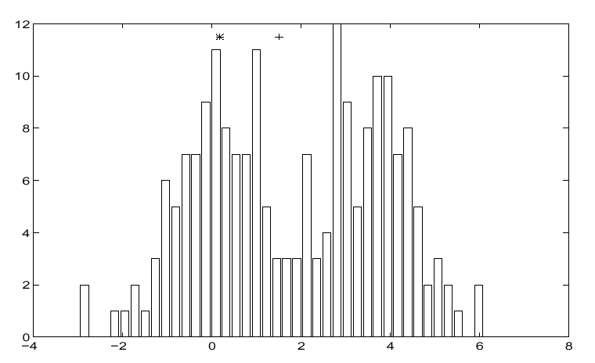
Finding Modes in a Histogram
How Many Modes Are There?
Easy to see, hard to compute

Slide 41
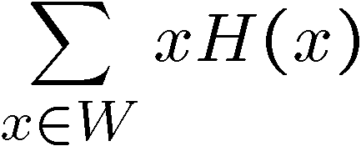
Mean Shift [Comaniciu & Meer]
Iterative Mode Search
Initialize random seed, and window W
Calculate center of gravity (the “mean”) of W:
Translate the search window to the mean
Repeat Step 2 until convergence

Slide 42
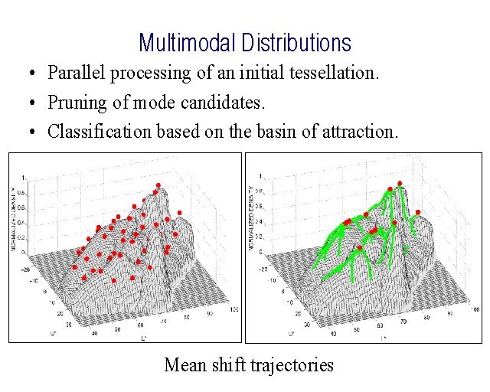
Mean-Shift
Approach
Initialize a window around each point
See where it shifts—this determines which segment it’s in
Multiple points will shift to the same segment

Slide 43
Mean shift clustering
The mean shift algorithm seeks modes of the given set of points
Choose kernel and bandwidth
For each point:
Center a window on that point
Compute the mean of the data in the search window
Center the search window at the new mean location
Repeat (b,c) until convergence
Assign points that lead to nearby modes to the same cluster

Slide 44
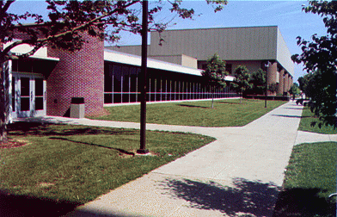
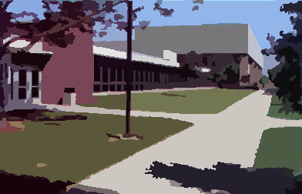
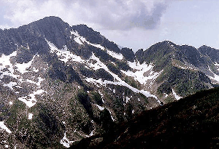
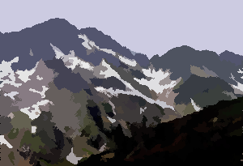
Mean shift segmentation results
CV 11: Image Segmentation
http://www.caip.rutgers.edu/~comanici/MSPAMI/msPamiResults.html

Slide 45
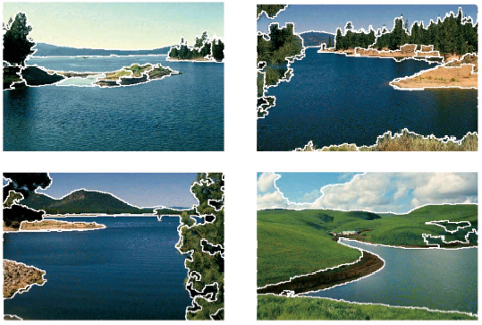
http://www.caip.rutgers.edu/~comanici/MSPAMI/msPamiResults.html

Slide 46
Mean-shift: other issues
Speedups
Binned estimation
Fast search of neighbors
Update each window in each iteration (faster convergence)
Other tricks
Use kNN to determine window sizes adaptively
Lots of theoretical support
D. Comaniciu and P. Meer, Mean Shift: A Robust Approach toward Feature Space Analysis, PAMI 2002.

Slide 47
Mean shift pros and cons
Pros
Good general-practice segmentation
Flexible in number and shape of regions
Robust to outliers
Cons
Have to choose kernel size in advance
Not suitable for high-dimensional features
When to use it
Oversegmentatoin
Multiple segmentations
Tracking, clustering, filtering applications

Slide 48
Region-based segmentation
Color histograms don’t take into account spatial info
Gestalt laws point out importance of spatial grouping
proximity, similarity, continuation, closure, common fate
Suggests that regions are important

Slide 49
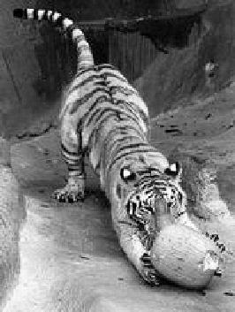
Images as graphs
q
C_{pq}
c
p
Fully-connected graph
node for every pixel
link between every pair of pixels, p,q
cost c_{pq} for each link
c_{pq} measures similarity
similarity is inversely proportional to difference in color and position
this is different than the costs for intelligent scissors

Slide 50
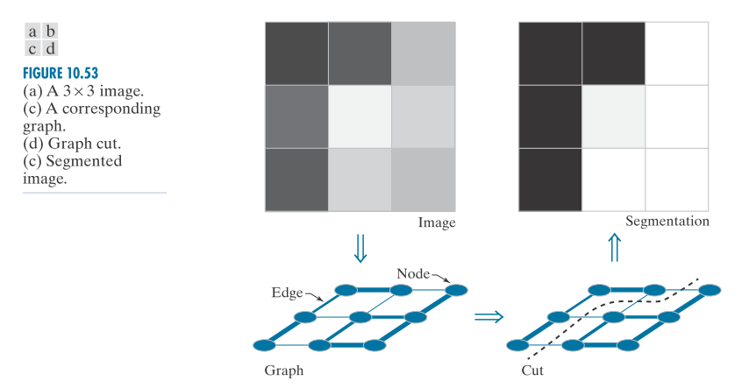
Images as graphs

Slide 51
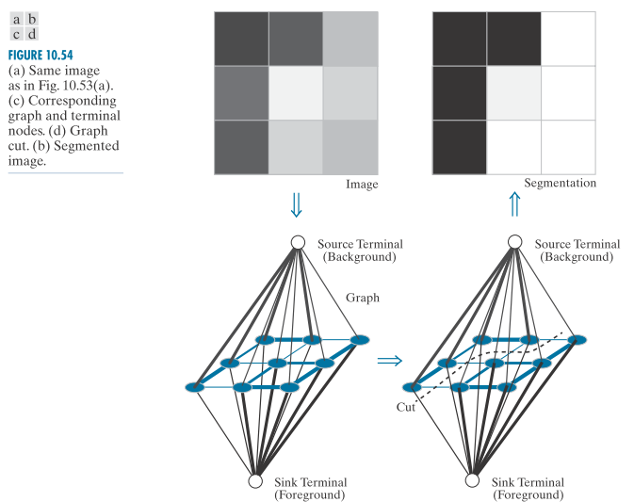
Images as graphs

Slide 52
Segmentation by Graph Cuts
w
A
B
C
Break Graph into Segments
Delete links that cross between segments
Easiest to break links that have high cost
similar pixels should be in the same segments
dissimilar pixels should be in different segments

Slide 53
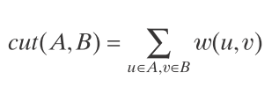
Cuts in a graph
B
A
Link Cut
set of links whose removal makes a graph disconnected
cost of a cut:
Find minimum cut
gives you a segmentation
fast algorithms exist for doing this
Notes:
min-cut approach offers an elegant solution, it can result in group-
ings that favor cutting small sets of isolated nodes in a graph, leading to improper
segmentations.

Slide 54
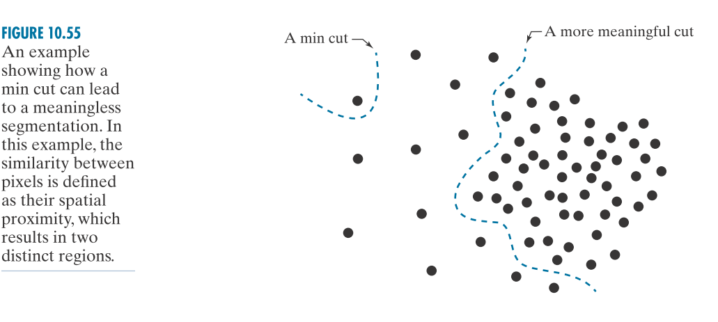
But min cut is not always the best cut...

Slide 55
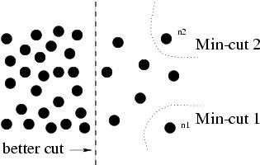
But min cut is not always the best cut...

Slide 56

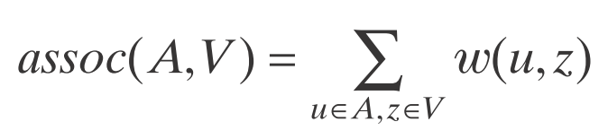

Cuts in a graph
B
A
Normalized Cut
a cut penalizes large segments
fix by normalizing for size of segments
Notes:
Instead of looking at the total weight value of the edges that connect two parti-
tions, the idea is to work with a measure of “disassociation” that computes the cost
as a fraction of the total edge connections to all nodes in the graph. This measure,
called the normalized cut (Ncut),
By using Ncut A B ( , ) instead of cut A B ( , ), the cut that partitions isolated points
will no longer have small values.
Based on the preceding discussion, image segmentation using graph cuts is now
based on ﬁnding a partition that minimizes Ncut A B ( , ). Unfortunately, minimizing
this quantity exactly is an NP-complete computational task, and we can no longer
rely on the solutions available for max ﬂow because the approach being followed
now is based on the concepts explained in connection with Fig. 10.53. However, Shi
and Malik [2000] (see also Hochbaum [2010]) were able to ﬁnd an approximate dis-
crete solution to minimizing Ncut A B ( , ) by formulating minimization as a general-
ized eigenvalue problem, for which numerous implementations exist

Slide 57
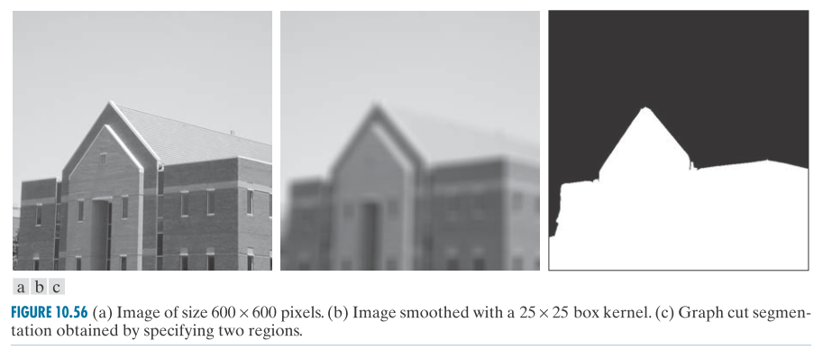
Cuts in a graph
Notes:
Graph cuts are ideally suited for obtaining a rough segmentation of the principal regions in an image. Figure 10.56 shows a typical result. Figure 10.56(a) is the familiar building image. Consistent with the idea of extracting the principal regions of an image, Fig. 10.56(b) shows the image smoothed with a simple 25 25 × box kernel. Observe how the ﬁne detail is smoothed out, leaving only major regional features such as the facade and sky. Figure 10.56(c) is the result of segmentation using the graph cut algorithm just developed, with weights of the form discussed in the previous example, and allowing only two partitions. Note how well the region corresponding to the building was extracted, with none of the details characteristic of the methods discussed earlier in this chapter. In fact, it would have been nearly impossible to obtain comparable results using any of the methods we have discussed thus far without signiﬁcant additional processing. This type of result is ideal for tasks such as providing broad cues for autonomous navigation, for searching image databases, and for low-level image analysis.

Slide 58
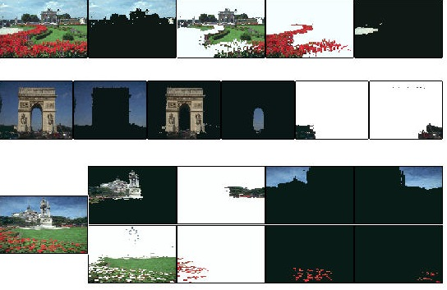
Color Image Segmentation
CV 11: Image Segmentation

Slide 59
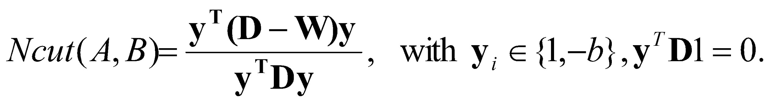

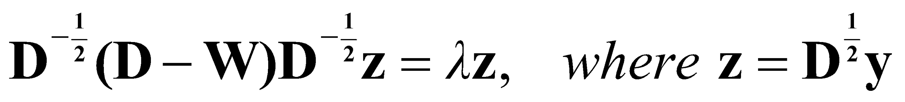
Normalize Cut in Matrix Form
W
is
the
cost
matrix
:
W
(
i
,
j
)
=
c
;
i
,
j
D
is
the
sum
of
costs
from
node
i
:
D
(
i
,
i
)
=
∑
W
(
i
,
j
); D(i,j) = 0
j
Can write normalized cut as:
Solution given by “generalized” eigenvalue problem:
Solved by converting to standard eigenvalue problem:
optimal solution corresponds to second smallest eigenvector
for more details, see
J. Shi and J. Malik, Normalized Cuts and Image Segmentation, IEEE Conf. Computer Vision and Pattern Recognition(CVPR), 1997
http://www.cs.washington.edu/education/courses/455/03wi/readings/Ncut.pdf
Notes:
How to get the split up from the second smallest eigen vector:
Thus, we can find the (continuous-valued) eigenvector corresponding to the second smallest eigenvalue using either a generalized or a standard eigenvalue solver. The
desired (discrete) vector x can be generated from the resulting, continuous valued solution vector by finding a splitting point that divides the values of the continuous
eigenvector elements into two parts. We do this by finding the splitting point that yields the smallest value of Ncut A B ( , ), since this is the quantity we are trying to
minimize. To simplify the search, we divide the range of values in the continuous vector into Q evenly spaced values, evaluate Eq. (10-104) for each value, and choose
the splitting point that yields the smallest value of Ncut A B ( , ). Then, all values of the eigenvector with values above the split point are assigned the value 1; all others are
assigned the value − 1. The result is the desired vector x. Then, partition A is the set nodes in V corresponding to 1’s in x; the remaining nodes correspond to partition B.

